Slide 1
Section 8.4
Surface Area of a cylinder
Copyright All Rights Reserved Homework Depot at www.BCMath.ca

Slide 2

Review: Area and Circumference of Circles
The area of a circle is the space inside the circle
Equation for Area of a Circle =  x r x r
[ = 3.14159162] [ ‘r’ is the radius of the circle]
The circumference of a circle is the distance around the perimeter of the circle
Equation for Circumference of a circle = 2 x  x r
Click here to understand why the area of a circle is A=r²
Copyright All Rights Reserved Homework Depot at www.BCMath.ca

Slide 3
Ex: given the following circles, find the area and circumference:
In this circle, we have the diameter instead of the radius
Divide the diameter by 2 to get the radius
Note: 10² is 10 times 10. Not 10 times 2!!!
Leaving your answer as 100 is ok
Copyright All Rights Reserved Homework Depot at www.BCMath.ca

Slide 4

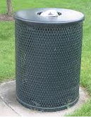


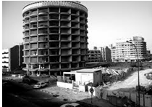
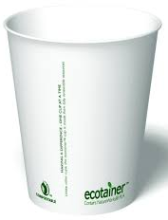


What is a Cylinder?
A cylinder is a prism where both ends of the solid are circles
Cylinders can be seen in almost everywhere in the world
Ex: Given each object, indicate whether if it is a cylinder or not
No because the circles at the top & bottom have different sizes
No because the bottom is not a circle
No because the side is not straight!!
Copyright All Rights Reserved Homework Depot at www.BCMath.ca

Slide 5
Surface Area of Cylinders
The top and bottom of a cylinder are circles. The equation for the area is
The lateral side of the cylinder is a rectangle.
The height is “h” and the width is the circumference of the circle
This part is for the area of both circles at the top and bottom
This part is for the lateral side of the cylinder
[Rectangle]
Copyright All Rights Reserved Homework Depot at www.BCMath.ca

Slide 6
Ex: Find the surface of the following cylinder
Find the area of both circles
Find the area of the lateral side
Now get the surface area by adding
the area of all three sides
Leaving your answer as 216 cm² is ok
Copyright All Rights Reserved Homework Depot at www.BCMath.ca

Slide 7
Practice Find the Surface of the following Solids:
The diameter is 8cm. Find the radius by dividing the diameter by 2
Find the area of both circles
Find the area of the lateral side
Now get the surface area by adding
the area of all three sides
Leaving your answer as 112 cm² is ok
Copyright All Rights Reserved Homework Depot at www.BCMath.ca

Slide 8
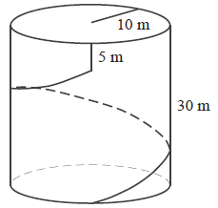
Ex: A water tower in the shape of a cylinder has radius 10 m and height 30 m. A spiral staircase, with constant slope, circles once around the outside of the water tower. A vertical ladder of height 5 m then extends to the top of the tower. What is the total distance along the staircase and up the ladder to the top of the tower?
Unwrap the cylinder for the lateral surface
Use the Pythagorean Thm. to find
the length of the diagonal path
The total distance travelled will be:

Slide 9
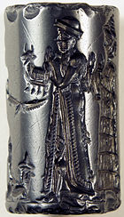
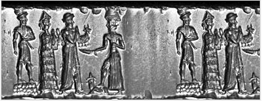
Homework:
P 186 #4, 6, 8 – 12
Copyright All Rights Reserved Homework Depot at www.BCMath.ca

Slide 10
Area of a Circle:
To find the area of a circle, cut it into 8 equal pieces
Put the pieces together to create a parallelogram
The length of the top is equal to half the perimeter
The height is equal to the radius of the circle
Copyright All Rights Reserved Homework Depot at www.BCMath.ca

